Slide 1
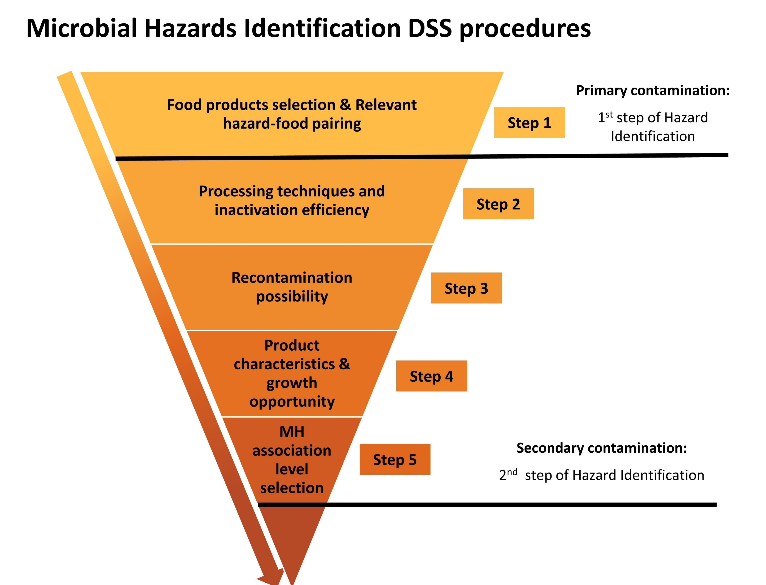
RR of identified MHs
RR of all 32 relevant MHs

Slide 2











Microbial Hazards Risk Ranking DSS Procedures
Steps 1-5 are the same as MH identification
Step 1
Step 2
Step 3
Tree 2
Tree 3
Start
Raw materials
Food products selection
& relevant hazard-food pairing
Processing techniques & inactivation efficacy
Recontamination possibility
Tree 4
Step 4a
Step 5
Step 4b
Post-processing Control
(extrinsic factor-environment)
Tree 6
Tree 4
Hazard Food Characteristic
Steps 2-5
HFC
Effect of meal preparation
Post-processing Control
(intrinsic factor-growth opportunity in food)
Step 6
Step 7
Step 8
Tree 7
Tree 8
Tree 9
Hazard Food Association
Outbreak prevalence
Contamination prevalence
Sampling prevalence
Food Consumption
Hazard Severity
DALY/case
Notes:
Meal preparation is not in the hazard identification step, because the cooking method does not determine which MHs are present or relevant, but rather which MHs are inactivated more efficiently.

Slide 3


Microbial Hazard Risk Ranking Criteria
C1 Probability
C2 Severity
C1A
C1B
C1C
Hazard-Food Characteristics
(HFC)
Hazard-Food Association
(HFA)
Food Consumption (FC)
DALY/case (HS)
Processing effect (S)
Recontamination possibility (C)
Post-processing control (PPE)
🠚 IF: growth opportunity
🠚 EF: storage/distribution/retail
Effect of meal preparation (MP)
Contamination prevalence
Outbreak prevalence
Sampling prevalence
Risk = [S+C]*PPE*MP*4√HFA*FC*HS

Slide 4
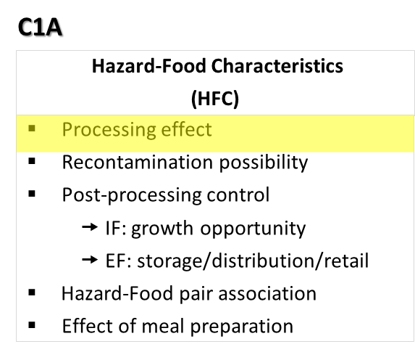
Step 2
Processing inactivation effect
Select the processing techniques
Table 1
Thermal
None
High risk
Hazard group | No inactivation
Vegetative bacteria | 1
Virus | 1
Vegetative parasites | 1
Parasite cysts | 1
Heat-resistant virus | 1
Bacterial spores | 1
Bacterial toxin | 1
HPP
Pasteurize
Table 1
PCD
Boil
Select food composition
RF
Sterilize
Table 2
Dry food
High fat
No
Hazard group | Pasteurization | Boiling | Sterilization
Vegetative bacteria | 1E-6 | 1E-10 | 1E-20
Virus | 1E-6 | 1E-10 | 1E-20
Vegetative parasites | 1E-6 | 1E-10 | 1E-20
Parasite cysts | 1E-05 | 1E-10 | 1E-20
Heat-resistant virus | 1E-03 | 1E-10 | 1E-20
Bacterial spores | 1 | 1E-03 | 1E-12
Bacterial toxin | 1 | 1E-03 | 1E-12
Low risk
*exception rule
low risk for Campylobacter in dry foods
Table 2
yes
Medium risk
Table 3
Table 3
Hazard group | Pasteurization | Boiling | Sterilization
Vegetative bacteria | 1E-4 | 1E-8 | 1E-18
Virus | 1E-4 | 1E-8 | 1E-18
Vegetative parasites | 1E-4 | 1E-8 | 1E-18
Parasite cysts | 1E-3 | 1E-8 | 1E-18
Heat-resistant virus | 1E-1 | 1E-8 | 1E-18
Bacterial spores | 1 | 1E-1 | 1E-10
Bacterial toxin | 1 | 1E-1 | 1E-10

Slide 5

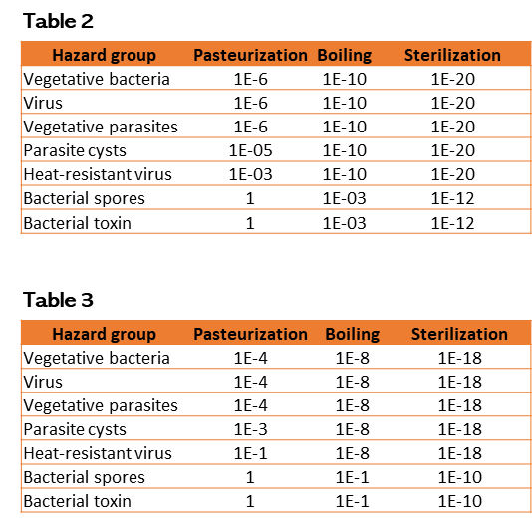
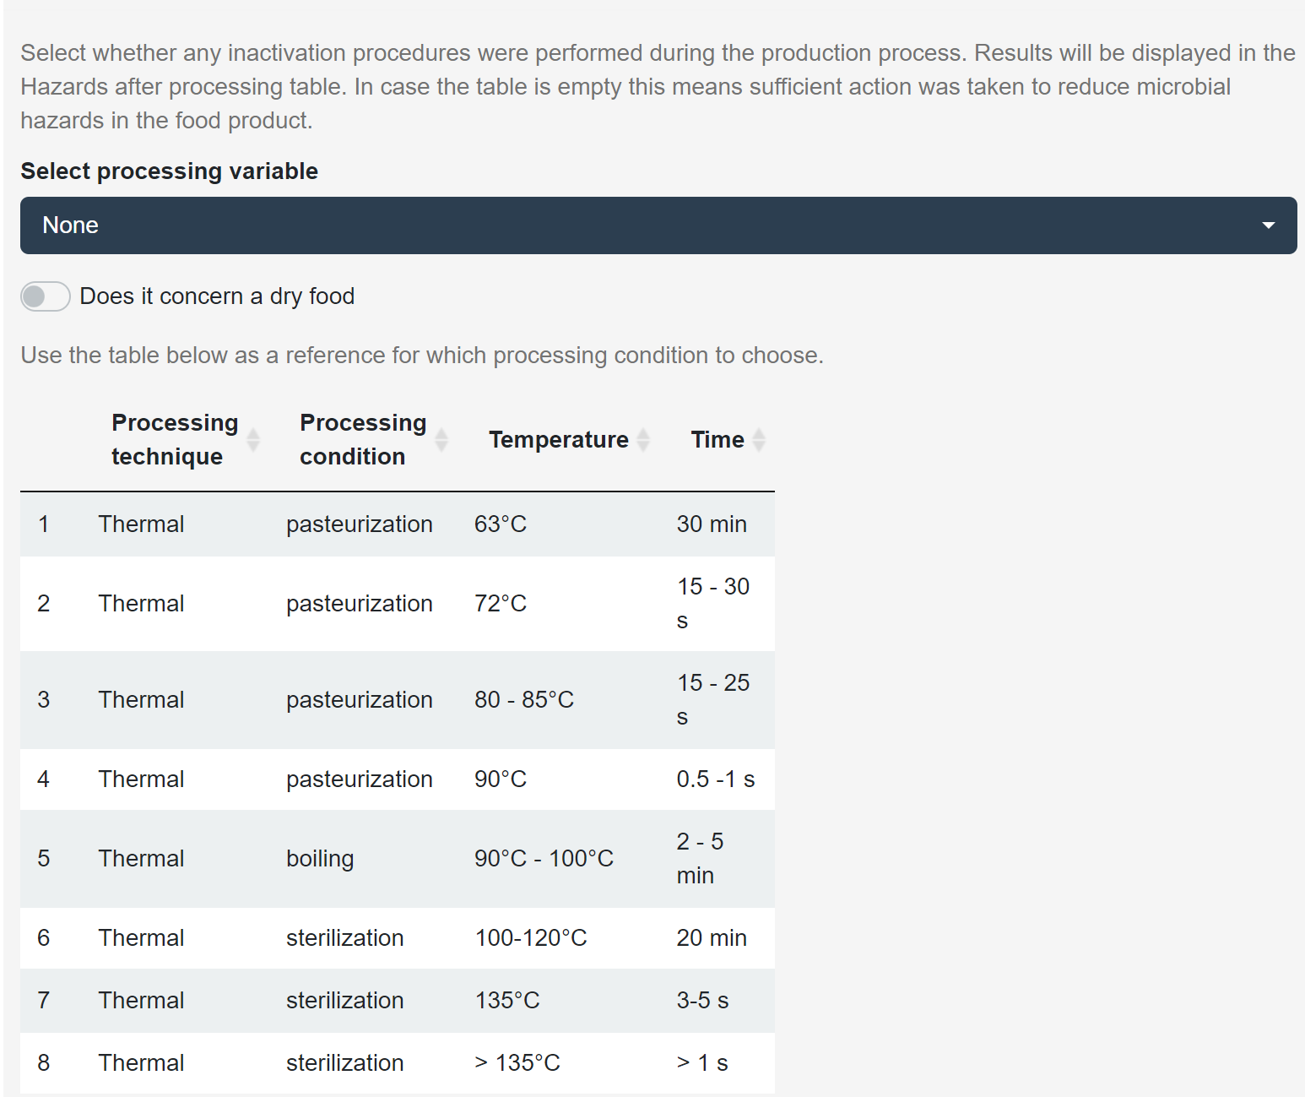

Slide 6
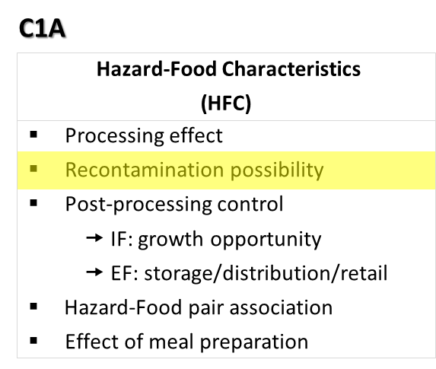
Step 3
Category of dry ingredients | Risk of recontamination for relevant hazard
dry spices | 0.5
other dry ingredients | 0.05
dry vitamins | 0.005
Recontamination possibility
RP = RP environmental factor * RP food handling
Food handling
No risk and no addition of other ingredients
*Zero here indicates the entire branch of recontamination will be excluded from RR instead of multiplying with the value zero
Processing in close bag?
0
Environmental factor
Addition of unprocessed ingredients?
Include possible environmental contaminants?
Dry or wet?
Major risk with MH- dry/wet ingredients
Minor risk with MH- humans
X
Dry/Wet?
0.5
0.005
Human contact with food?
Human contact with food?
None/very low risk
Minor risk with MH- dry/wet environment
Major risk with MH- dry/wet ingredients
Minor risk with MH- dry/wet ingredients
1E-6
None/very low risk
Minor risk with MH- humans
0.5
0.005
0.005
1E-6
0.005
*Assuming 50% of 100% of unprocessed ingredients may be contaminated
*Assuming 0.1% of 100% may be contaminated with microbial hazards associated with the environment
*Assuming 0.1% of 100% food may be contaminated when contacted with food handlers

Slide 7
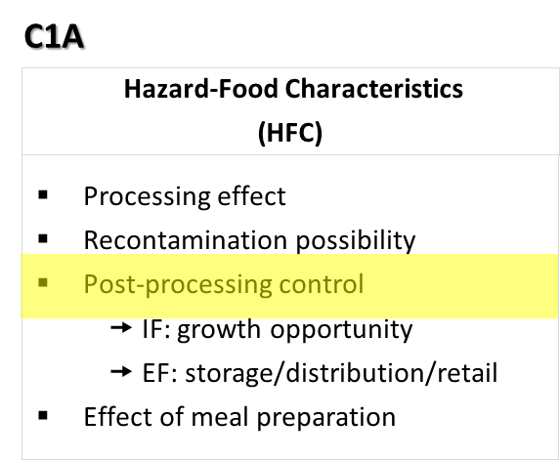
Step 4
Post-processing control
Growth Opportunity
Hazard needs growth in food to cause illness?
Food characteristic ?
pH <4.5 or >4.5
Dry/half dry/wet
Food characteristics support hazard growth?
Storage/distribution/retailing conditions
RT
Cold
1-4°C
Freeze
0°C
Potential temperature abuse?
High risk
medium risk
low risk
1
1.00E-03
1.00E-06

Slide 8
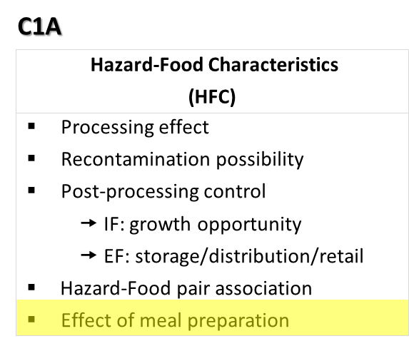
Step 6
Effect of meal preparation
Further cooking/prep process involved?
Ready to eat foods
Thermal Cooking > 70°C
Table 4
High risk
Medium risk
low risk
Hazard group | Cooking <70C | Cooking >70C
Vegetative bacteria | 1E-2 | 1E-4
Virus | 1E-2 | 1E-4
Vegetative parasites | 1E-2 | 1E-4
Parasite cysts | 1E-1 | 1E-03
Heat-resistant virus | 1 | 1E-02
Bacterial spores | 1 | 1
Bacterial toxin | 1 | 1
1
Table 4
Table 4
* Meal preparation ELIMINATES no hazards

Slide 9
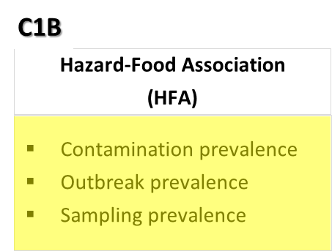
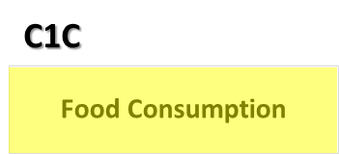
Step 7
Step 8
F. Hazard Prevalence
G. Food Consumption
Consumption % by Infants/toddlers in EU ?
Contamination alerts
(US & EU)
Outbreak
(US & EU)
Sampling
(meta-analysis)
Actual consumption percentage in the population of infants and toddlers up to the age of 3 in EU (%)
NR
Strength of evidence (%)
*Assuming 1/million chance it may be the exception
1E-6

Slide 10
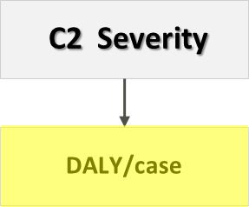
Step 9
Hazard severity
DALY reported?
DALY/case <0.05
Low impact hazard
Low-risk and usually self-limiting
DALY/case = 0.05- 0.5
Minor impact hazard
Minor risk and may require medical treatment
Other data available for calculation?
DALY/case = 0.51-5
Severe impact hazard
Medium risk and mainly require medical treatment
Assumption based on closely-related species that have similar sequelae
High risk and causes severe illness/death to victims
DALY/case > 5
Critical impact hazard

Slide 11
Microbial Hazard Risk Ranking Criteria
C1 Probability
C2 Severity
C1A
C1B
C1C
Hazard-Food Characteristics
(HFC)
Hazard-Food Association
(HFA)
Food Consumption (FC)
DALY/case (HS)
Processing effect (S)
Recontamination possibility (C)
Post-processing control (PPE)
🠚 IF: growth opportunity
🠚 EF: storage/distribution/retail
Effect of meal preparation (MP)
Contamination prevalence
Outbreak prevalence
Sampling prevalence
Risk = [S+C]*PPE*MP*4√HFA*FC*HS

Slide 12








Microbial Hazards Risk Ranking DSS Procedures
Step 1
Food products selection & relevant hazard-food pairing
User input
Step 2 - 6
Hazard food characteristics of the selected food products
Step 7
Hazard Food Association of the selected food products
Step 8
Food consumption
Step 9
Hazard severity of the identified hazards
Step 10
Include or exclude criteria
User optional selection
Step 11
Select risk ranking methods
Step 12
Assign relative weight per criterion
Aggregation and display ranking results

Slide 13
Case study Description
 | Final risk value | Association count
Salmonella | 7.81245E-08 | 5
STEC | 7.66457E-09 | 5
Cronobacter | 5.52843E-09 | 3
C. bolutinum | 8.71459E-11 | 1
Cryptosporidium | 1.84364E-11 | 3
Norovirus | 1.29966E-12 | 2
B. cereus | 2.03919E-13 | 5
C. perfringens | 7.07722E-15 | 2
S. aureus | 1.43763E-18 | 5
Listeria | 0 | 5
Hepatitis A | 0 | 0
Trichinella | 0 | 0
Product: | Infant formula
Processing parameters | Thermal pasteurization (72°C, 30s)
Recontamination Possibility | Dry environment Addition of vitamins and trace elements
Post processing control | pH 6.5, Aw 0.2, transport at RT
Meal preparation | RTE
HFA | Food category: Milk and dairy products
Food consumption | 0.457
Step | Procedures description | Salmonella | STEC | S. aureus | Cronobacter | Listeria | Hepatitis A | Norovirus | B. cereus | C. bolutinum | C. perfringens | Trichinella | Cryptosporidium
Step 2 | Processing inactivation = chance of survival | 1.00E-06 | 1.00E-06 | 1.00E-06 | 1.00E-06 | 1.00E-06 | 1.00E-03 | 1.00E-06 | 1 | 1 | 1 | 1.00E-06 | 1.00E-05
Step 3 | Recontamination possibility (food) | 0.005 | 0.005 | 0.005 | 0.005 | 1.00E-06 | 0.005 | 0.005 | 0.005 | 0.005 | 0.005 | 1.00E-06 | 1.00E-06
 | Recontamination possibility (dry environment) | 0.005 | 0.005 | 1.00E-06 | 0.005 | 1.00E-06 | 1.00E-06 | 1.00E-06 | 0.005 | 0.005 | 0.005 | 1.00E-06 | 1.00E-06
 | (S2+S3F*S3E) | 2.60E-05 | 2.60E-05 | 1.01E-06 | 2.60E-05 | 1.00E-06 | 1.00E-03 | 1.01E-06 | 1.00E+00 | 1.00E+00 | 1.00E+00 | 1.00E-06 | 1.00E-05
Step 4 | Post processing control | 1 | 1 | 1.00E-06 | 1 | 1.00E-06 | 1 | 1 | 1.00E-06 | 1.00E-06 | 1.00E-06 | 1 | 1
Step 5 | effect of meal preparation | 1 | 1 | 1 | 1 | 1 | 1 | 1 | 1 | 1 | 1 | 1 | 1
 | Total C1A (S2+S3F*S3E)*S4*S5 | 2.60E-05 | 2.60E-05 | 1.01E-12 | 2.60E-05 | 1.00E-12 | 1.00E-03 | 1.01E-06 | 1.00E-06 | 1.00E-06 | 1.00E-06 | 1.00E-06 | 1.00E-05
Step 6 | Prevalence A | 0.153846154 | 0.038461538 | 0.132478632 | 1.00E-06 | 0.000001 | 0.000001 | 0.0213675 | 0.025641026 | 1.00E-06 | 1.00E-06 | 1.00E-06 | 0.004273504
 | Prevalence B | 0.117647059 | 0.160427807 | 0.005347594 | 1.00E-06 | 0.016042781 | 0.000001 | 0.0160428 | 1.00E-06 | 0.005347594 | 0.005347594 | 1.00E-06 | 0.037433155
 | Prevalence C | 0.25 | 0.175 | 0.025 | 0.025 | 0.325 | 0.000001 | 1.00E-06 | 0.075 | 1.00E-06 | 1.00E-06 | 1.00E-06 | 1.00E-06
 | Prevalence D | 0.588785047 | 0.009345794 | 1.00E-06 | 0.028037383 | 0.317757009 | 0.028037383 | 1.00E-06 | 0.018691589 | 0.009345794 | 1.00E-06 | 1.00E-06 | 1.00E-06
 | HFA_4th root | 0.227191001 | 0.056362486 | 0.002051451 | 0.000162712 | 0.00637991 | 1.294E-05 | 0.0001361 | 0.00244856 | 8.40802E-05 | 8.55145E-06 | 0.000001 | 0.000112463
Step 7 | Food consumption | 0.4752 | 0.4752 | 0.4752 | 0.4752 | 0.4752 | 0.4752 | 0.4752 | 0.4752 | 0.4752 | 0.4752 | 0.4752 | 0.4752
Step 8 | Hazard severity | 0.028 | 0.011006463 | 0.001467384 | 2.75 | 8.352036135 | 0.098744215 | 0.02 | 0.000 | 2.181 | 0.002 | 0.12298748 | 0.034497697
 | Hazard identified in Midi app | 1 | 1 | 1 | 1 | 0 | 0 | 1 | 1 | 1 | 1 | 0 | 1
 | Final risk value | 7.81E-08 | 7.66E-09 | 1.44E-18 | 5.53E-09 | 2.53E-14 | 6.07E-10 | 1.30E-12 | 2.04E-13 | 8.71E-11 | 7.08E-15 | 5.84E-14 | 1.84E-11
 | Final risk value_only HI | 7.81E-08 | 7.66E-09 | 1.44E-18 | 5.53E-09 | 0 | 0 | 1.30E-12 | 2.04E-13 | 8.71E-11 | 7.08E-15 | 0 | 1.84E-11

Slide 14
Case study Description
Product: | Fruit puree
Processing parameters | Thermal boiling (95°C, 3 min)
Recontamination Possibility | (no environment contaminant) Addition of vitamins and trace elements
Post processing control | pH 3.8, Aw 0.99, transport at RT
Meal preparation | RTE
HFA | Food category: Food of non-animal origin_fruits and vegetables
Food consumption | 0.457
 | Final risk value | Association count
B. cereus | 1.05327E-10 | 4
Listeria | 1.18939E-11 | 5
C. bolutinum | 7.64122E-12 | 3
Salmonella | 6.53524E-12 | 5
STEC | 5.12353E-13 | 5
Norovirus | 5.85804E-14 | 4
Cronobacter | 2.32002E-14 | 0
S. aureus | 1.45941E-14 | 2
C. perfringens | 4.64466E-16 | 4
Cryptosporidium | 8.06854E-17 | 3
Trichinella | 2.82843E-18 | 0
Hepatitis A | 7.57334E-19 | 4
 |  | Salmonella | STEC | S. aureus | Cronobacter | Listeria | Hepatitis A | Norovirus | B. cereus | C. bolutinum | C. perfringens | Trichinella | Cryptosporidium
Step 2 | Processing inactivation = chance of survival | 1E-10 | 1E-10 | 1E-10 | 1E-10 | 1E-10 | 1E-10 | 1E-10 | 0.001 | 0.001 | 0.001 | 1E-10 | 1E-10
Step 3 | Recontamination possibility (dry ingredients) | 0.005 | 0.005 | 0.005 | 0.005 | 1.00E-06 | 1.00E-06 | 1.00E-06 | 0.005 | 0.005 | 0.005 | 1.00E-06 | 1.00E-06
 | Recontamination possibility environment (none) | 1.00E-06 | 1.00E-06 | 1.00E-06 | 1.00E-06 | 1.00E-06 | 1.00E-06 | 1.00E-06 | 1.00E-06 | 1.00E-06 | 1.00E-06 | 1.00E-06 | 1.00E-06
 | (S2+S3F*S3E) | 5.10E-09 | 5.10E-09 | 5.10E-09 | 5.10E-09 | 1.01E-10 | 1.01E-10 | 1.01E-10 | 1.00E-03 | 1.00E-03 | 1.00E-03 | 1.01E-10 | 1.01E-10
 | Post processing control | 1 | 1 | 1 | 1 | 1 | 1 | 1 | 1 | 1.00E-06 | 1.00E-06 | 1 | 1
Step 4 | effect of meal preparation | 1 | 1 | 1 | 1 | 1 | 1 | 1 | 1 | 1 | 1 | 1 | 1
Step 5 | Total C1A ((S2+S3F*S3E)*S4*S5 | 5.10E-09 | 5.10E-09 | 5.10E-09 | 5.10E-09 | 1.01E-10 | 1.01E-10 | 1.01E-10 | 1.00E-03 | 1.00E-09 | 1.00E-09 | 1.01E-10 | 1.01E-10
 | Prevalence A | 0.1122 | 1.22E-02 | 1.27E-01 | 0.000001 | 1.71E-02 | 0.000001 | 1.32E-01 | 9.76E-02 | 1.22E-02 | 4.63E-02 | 0.000001 | 1.46E-02
Step 6 | Prevalence B | 0.2368 | 1.01E-01 | 4.39E-03 | 0.000001 | 1.02E-02 | 0.001461988 | 4.88E-01 | 1.02E-02 | 1.90E-02 | 2.92E-03 | 0.000001 | 7.31E-03
 | Prevalence C | 0.1667 | 4.86E-02 | 6.94E-03 | 0.000001 | 1.74E-01 | 0.000001 | 3.26E-01 | 4.86E-02 | 6.94E-03 | 1.39E-02 | 0.000001 | 0.000001
 | Prevalence D | 0.3774 | 4.32E-02 | 1.39E-03 | 0.002785515 | 4.85E-01 | 0.000001 | 1.25E-02 | 0.000001 | 3.48E-02 | 0.000001 | 0.000001 | 0.000001
 | 4th root C1B | 0.202200219 | 0.040085563 | 0.008564449 | 7.26485E-06 | 0.061922304 | 6.18352E-06 | 0.1273616 | 0.00263945 | 0.015386209 | 0.001171259 | 0.000001 | 0.0001017
 | Severity C2 | 0.028 | 0.011006463 | 0.001467384 | 2.75 | 8.352036135 | 0.005325581 | 0.02 | 0.000 | 2.181 | 0.002 | 0.12298748 | 0.034497697
Step 8 | FC C1C | 0.2277 | 0.2277 | 0.2277 | 0.2277 | 0.2277 | 0.2277 | 0.2277 | 0.2277 | 0.2277 | 0.2277 | 0.2277 | 0.2277
Step 7 | Final risk value | 6.54E-12 | 5.12E-13 | 1.46E-14 | 2.32E-14 | 1.19E-11 | 7.57E-19 | 5.86E-14 | 1.05E-10 | 7.64E-12 | 4.64E-16 | 2.83E-18 | 8.07E-17

Slide 15
Case study Description
 | Final risk value noTA | Final risk value TA | Association count
Salmonella | 1.28E-03 | 1.28E-03 | 5
Norovirus | 5.80E-04 | 5.80E-04 | 4
STEC | 1.00E-04 | 1.00E-04 | 5
Cronobacter | 4.55E-06 | 4.55E-06 | 0
S. aureus | 2.86E-06 | 2.86E-06 | 2
Cryptosporidium | 7.99E-07 | 7.99E-07 | 3
Listeria | 1.18E-07 | 1.18E-04 | 5
B. cereus | 1.05E-07 | 1.05E-07 | 4
Trichinella | 2.80E-08 | 2.80E-08 | 0
C. bolutinum | 7.64E-09 | 7.64E-06 | 3
Hepatitis A | 7.50E-09 | 7.50E-09 | 4
C. perfringens | 4.64E-13 | 4.64E-10 | 4
Product: | Fresh fruit
Processing parameters | None
Recontamination Possibility | Human handling Spraying of water vapor
Post processing control | pH 4.2, Aw = 0.98 Tranported 4°C, potential temperature abuse
Meal preparation | None
HFA | RTE
Food consumption | 1
 |  | Salmonella | STEC | S. aureus | Cronobacter | Listeria | Hepatitis A | Norovirus | B. cereus | C. bolutinum | C. perfringens | Trichinella | Cryptosporidium
Step 2 | Processing inactivation = chance of survival | 1 | 1 | 1 | 1 | 1 | 1 | 1 | 1 | 1 | 1 | 1 | 1
Step 3 | Recontamination possibility (human) | 1.00E-06 | 1.00E-06 | 0.005 | 1.00E-06 | 1.00E-06 | 0.005 | 0.005 | 1.00E-06 | 1.00E-06 | 1.00E-06 | 1.00E-06 | 1.00E-06
 | Recontamination possibility (wet environment) | 1.00E-06 | 1.00E-06 | 1.00E-06 | 1.00E-06 | 0.005 | 1.00E-06 | 1.00E-06 | 1.00E-06 | 1.00E-06 | 1.00E-06 | 1.00E-06 | 1.00E-06
 | (S2+S3F*S3E) | 1.00E+00 | 1.00E+00 | 1.00E+00 | 1.00E+00 | 1.00E+00 | 1.00E+00 | 1.00E+00 | 1.00E+00 | 1.00E+00 | 1.00E+00 | 1.00E+00 | 1.00E+00
Step 4 | Post processing control | 1 | 1 | 1 | 1 | 1.00E-06 | 1 | 1 | 1 | 1.00E-06 | 1.00E-06 | 1 | 1
Step 5 | effect of meal preparation | 1 | 1 | 1 | 1 | 1 | 1 | 1 | 1 | 1 | 1 | 1 | 1
 | Total C1A ((S2+S3F*S3E)*S4*S5 | 1.00E+00 | 1.00E+00 | 1.00E+00 | 1.00E+00 | 1.00E-06 | 1.00E+00 | 1.00E+00 | 1.00E+00 | 1.00E-06 | 1.00E-06 | 1.00E+00 | 1.00E+00
Step 6 | Prevalence A | 0.112195 | 0.012195 | 0.126829 | 0.000001 | 0.017073 | 0.000001 | 0.131707 | 0.097561 | 0.012195 | 0.046341 | 0.000001 | 0.014634
 | Prevalence B | 0.236842 | 0.100877 | 0.004386 | 0.000001 | 0.010234 | 0.001462 | 0.488304 | 0.010234 | 0.019006 | 0.002924 | 0.000001 | 0.007310
 | Prevalence C | 0.166667 | 0.048611 | 0.006944 | 0.000001 | 0.173611 | 0.000001 | 0.326389 | 0.048611 | 0.006944 | 0.013889 | 0.000001 | 0.000001
 | Prevalence D | 0.377437 | 0.043175 | 0.001393 | 0.002786 | 0.484680 | 0.000001 | 0.012535 | 0.000001 | 0.034819 | 0.000001 | 0.000001 | 0.000001
 | 4th root C1B | 0.202200219 | 0.040085563 | 0.008564449 | 7.26485E-06 | 0.061922304 | 6.18352E-06 | 0.1273616 | 0.00263945 | 0.015386209 | 0.001171259 | 0.000001 | 0.0001017
Step 8 | Severity C2 | 0.028 | 0.011006463 | 0.001467384 | 2.75 | 8.352036135 | 0.005325581 | 0.02 | 0.000 | 2.181 | 0.002 | 0.12298748 | 0.034497697
Step 7 | FC C1C | 0.2277 | 0.2277 | 0.2277 | 0.2277 | 0.2277 | 0.2277 | 0.2277 | 0.2277 | 0.2277 | 0.2277 | 0.2277 | 0.2277
 | Final risk value | 1.28E-03 | 1.00E-04 | 2.86E-06 | 4.55E-06 | 1.18E-07 | 7.50E-09 | 5.80E-04 | 1.05E-07 | 7.64E-09 | 4.64E-13 | 2.80E-08 | 7.99E-07

Slide 16
Case study Description
Product: | Simple cereal
Processing parameters | Thermal pasteurization (65°C, 2X 1-3 min)
Recontamination Possibility | (Dry environment contaminant) Addition of vitamins and trace elements
Post processing control | pH 5.5, Aw 0.4, transport at RT
Meal preparation | Cooking < 70°C
HFA | Food category: Food of non-animal origin_cereal and cereal products
Food consumption | 0.457
 | Final risk value | Association count
Salmonella | 2.84E-11 | 4
C. bolutinum | 2.19E-12 | 1
Cronobacter | 1.15E-12 | 0
Hepatitis A | 7.37E-13 | 0
STEC | 6.19E-13 | 3
Cryptosporidium | 2.98E-14 | 1
Norovirus | 4.11E-15 | 2
B. cereus | 2.50E-15 | 4
C. perfringens | 2.41E-16 | 3
Trichinella | 1.70E-16 | 0
Listeria | 2.36E-18 | 2
S. aureus | 1.44E-22 | 4
 |  | Salmonella | STEC | S. aureus | Cronobacter | Listeria | Hepatitis A | Norovirus | B. cereus | C. bolutinum | C. perfringens | Trichinella | Cryptosporidium
Step 2 | Processing inactivation = chance of survival | 0.000001 | 0.000001 | 0.000001 | 0.000001 | 0.000001 | 0.001 | 0.000001 | 1 | 1 | 1 | 0.000001 | 0.00001
Step 3 | Recontamination possibility (food) | 5.00E-03 | 5.00E-03 | 0.005 | 5.00E-03 | 1.00E-06 | 0.005 | 0.005 | 5.00E-03 | 5.00E-03 | 5.00E-03 | 1.00E-06 | 1.00E-06
 | Recontamination possibility (dry environment) | 5.00E-03 | 5.00E-03 | 1.00E-06 | 5.00E-03 | 0.000001 | 1.00E-06 | 1.00E-06 | 5.00E-03 | 5.00E-03 | 5.00E-03 | 1.00E-06 | 1.00E-06
 | (S2+S3F*S3E) | 2.60E-05 | 2.60E-05 | 1.01E-06 | 2.60E-05 | 1.00E-06 | 1.00E-03 | 1.01E-06 | 1.00E+00 | 1.00E+00 | 1.00E+00 | 1.00E-06 | 1.00E-05
Step 4 | Post processing control | 1 | 1 | 1.00E-06 | 1 | 1.00E-06 | 1 | 1 | 0.000001 | 1.00E-06 | 1.00E-06 | 1 | 1
Step 5 | effect of meal preparation | 0.01 | 0.01 | 0.01 | 0.01 | 0.01 | 1 | 0.1 | 1 | 1 | 1 | 0.01 | 0.1
 | Total C1A ((S2+S3F*S3E)*S4*S5 | 2.60E-07 | 2.60E-07 | 1.01E-14 | 2.60E-07 | 1.00E-14 | 1.00E-03 | 1.01E-07 | 1.00E-06 | 1.00E-06 | 1.00E-06 | 1.00E-08 | 1.00E-06
Step 6 | Prevalence A | 1.00E-06 | 1.00E-06 | 1.00E-06 | 1.00E-06 | 1.00E-06 | 1.00E-06 | 1.00E-06 | 1.00E-06 | 1.00E-06 | 1.00E-06 | 1.00E-06 | 1.52E-03
 | Prevalence B | 9.05E-01 | 4.76E-02 | 1.00E-06 | 1.00E-06 | 1.00E-06 | 1.00E-06 | 4.76E-02 | 1.00E-06 | 1.00E-06 | 1.00E-06 | 1.00E-06 | 1.00E-06
 | Prevalence C | 8.11E-01 | 4.50E-02 | 9.01E-03 | 1.80E-02 | 1.80E-02 | 1.00E-06 | 1.00E-06 | 2.70E-02 | 1.00E-06 | 1.00E-06 | 1.00E-06 | 1.00E-06
 | Prevalence D | 8.85E-01 | 2.78E-03 | 2.78E-03 | 1.00E-06 | 9.74E-02 | 1.00E-06 | 1.00E-06 | 4.17E-03 | 2.78E-03 | 1.00E-06 | 1.00E-06 | 1.00E-06
 | 4th root C1B | 0.028382165 | 0.001562904 | 7.07529E-05 | 1.15858E-05 | 0.000204653 | 0.000001 | 1.477E-05 | 0.00010305 | 7.26232E-06 | 0.000001 | 0.000001 | 6.24877E-06
Step 8 | Severity C2 | 0.028 | 0.011006463 | 0.001467384 | 2.75 | 8.352036135 | 0.005325581 | 0.02 | 0.000 | 2.181 | 0.002 | 0.12298748 | 0.034497697
Step 7 | FC C1C | 0.13835345 | 0.13835345 | 0.13835345 | 0.13835345 | 0.13835345 | 0.13835345 | 0.1383534 | 0.13835345 | 0.13835345 | 0.13835345 | 0.13835345 | 0.13835345
 | Final risk value | 2.84E-11 | 6.19E-13 | 1.44E-22 | 1.15E-12 | 2.36E-18 | 7.37E-13 | 4.11E-15 | 2.50E-15 | 2.19E-12 | 2.41E-16 | 1.70E-16 | 2.98E-14

